Slide 1

Finance & Technology
Soumya Gupta
Senior Functional Analyst
Deutsche Börse , Frankfurt
Germany

Slide 2

World vs. Virus
COVID-19‘s Impact on Financial Market

Slide 3
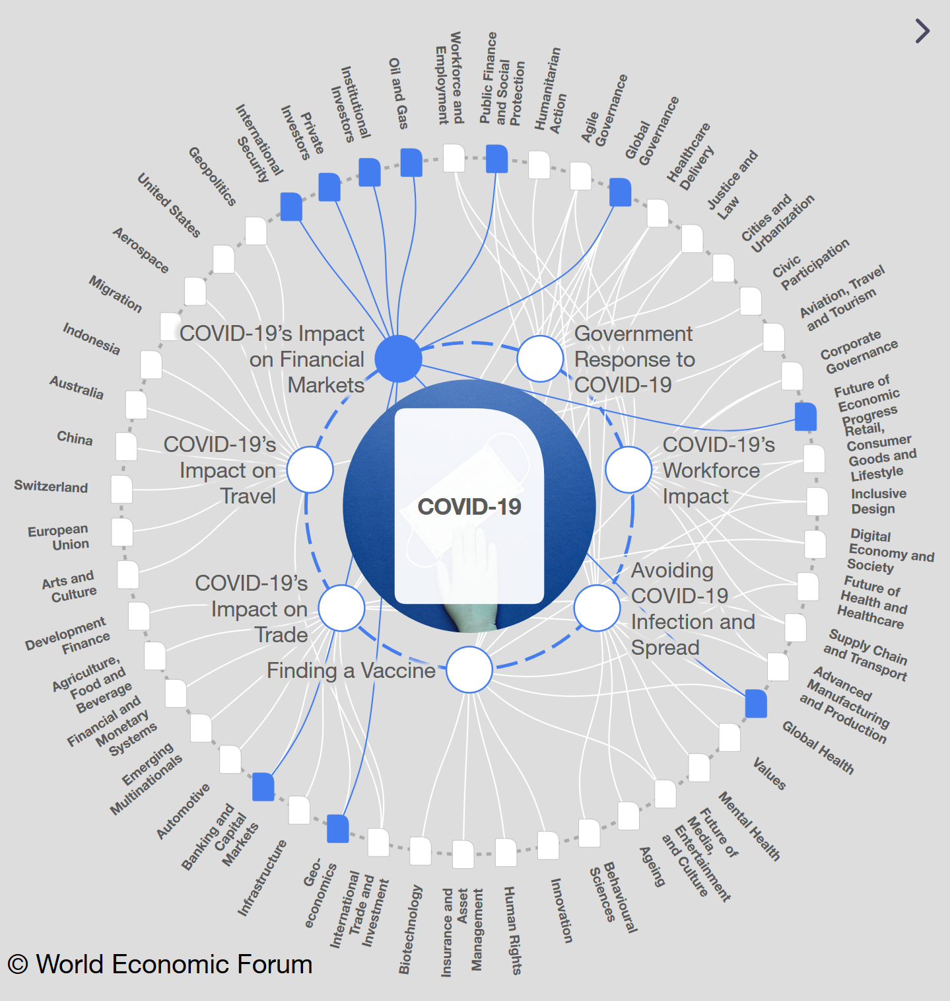
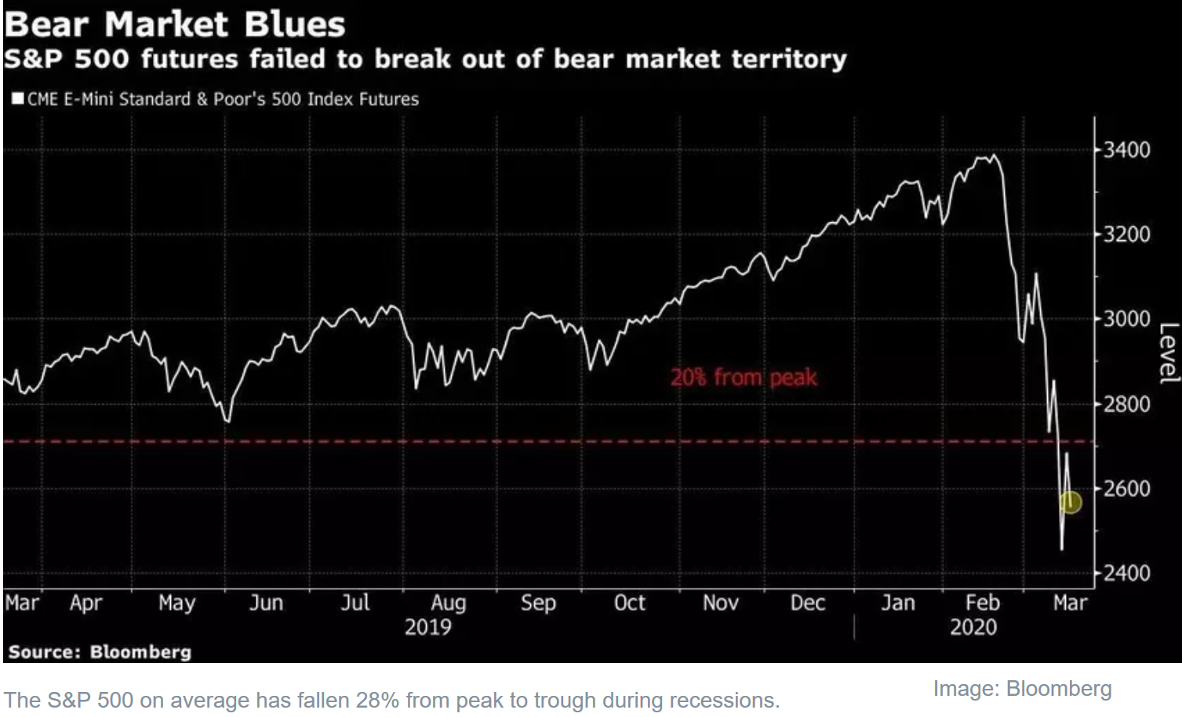
COVID-19 outbreak is leading investors to plan for situations more serious than a recession.
Current market analysis projecting a steep economic contraction in at least the coming quarters as governments in the United States, India and Europe start shutting restaurants, closing schools and calling on citizens to stay home.
The stock market has responded to the COVID-19 pandemic with worrying volatility, as traders have panic-sold out of fear.
Trading stopped four times
The S&P 500 triggered level 1 market wide circuit breakers during the opening hour on March 9, 12 and 16 based on drops of 7% from the previous close, and tripped later in the day on the 18th. Trading also halts on both the Dow and the Nasdaq when a circuit-breaker is triggered on the S&P 500. Registered its second-worst day of trading in its 124-year history.
VOLATILE PRESENCE
For more Strategic Insights and Contextual Intelligence please follow : https://intelligence.weforum.org/

Slide 4
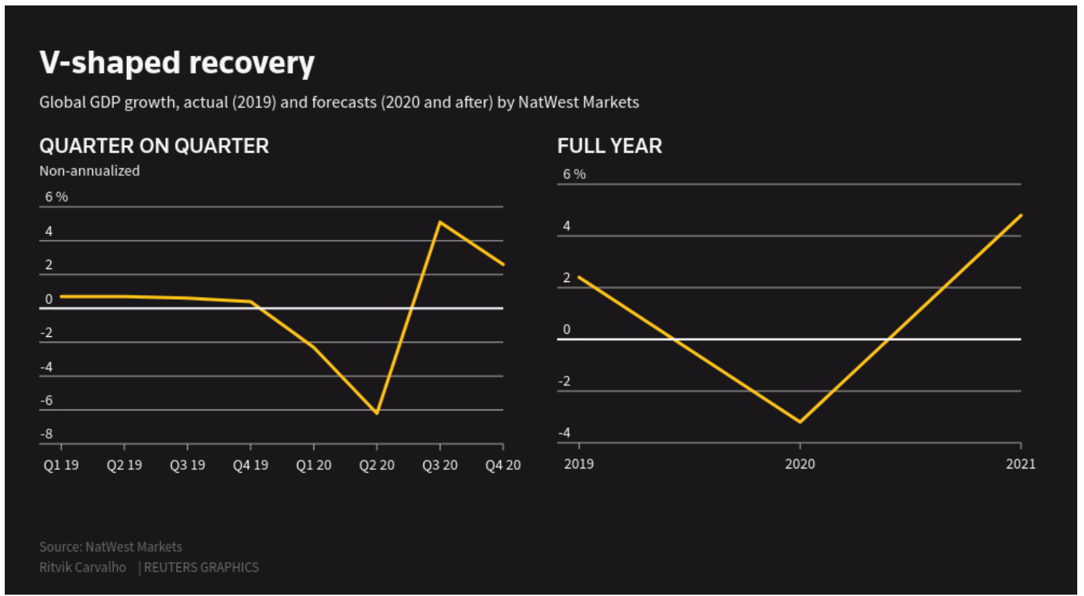
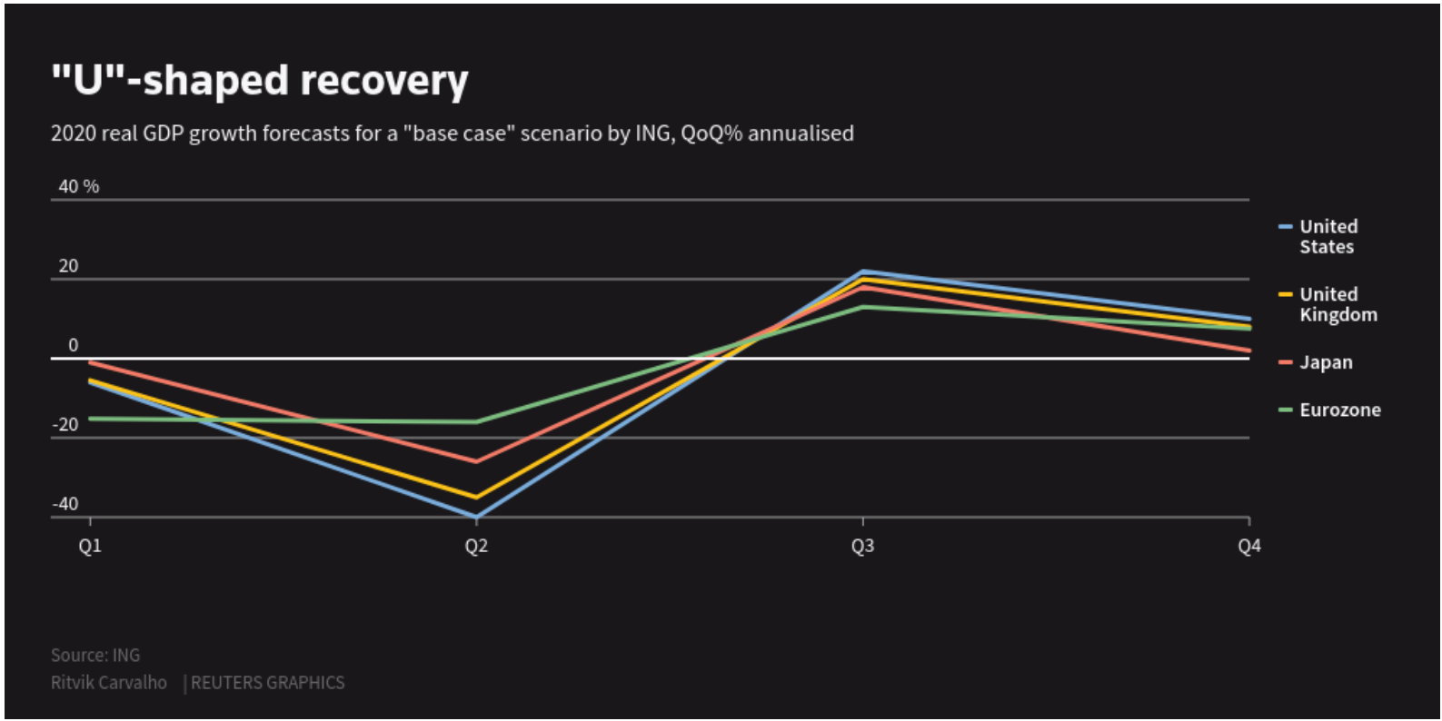
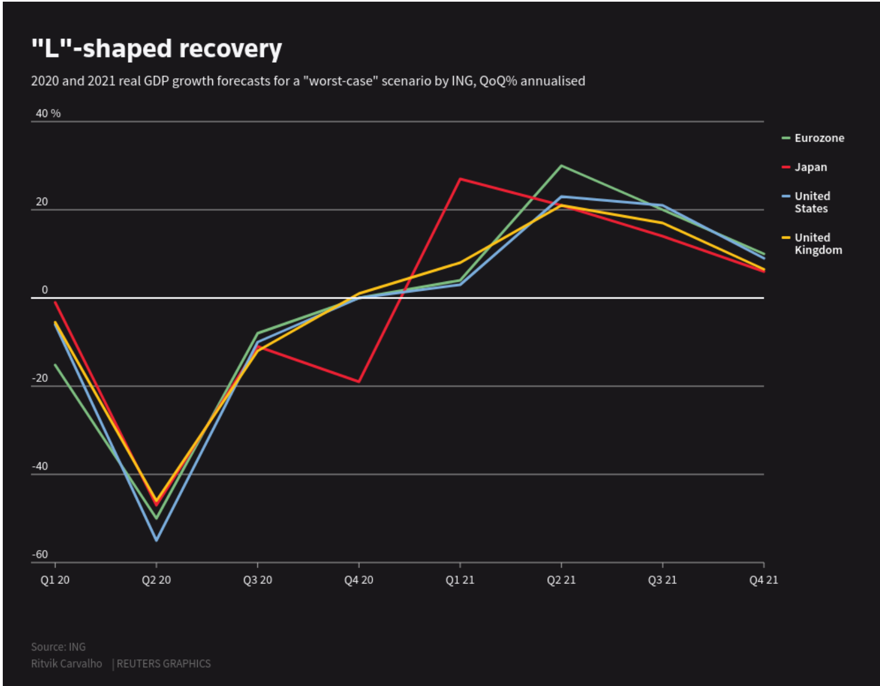
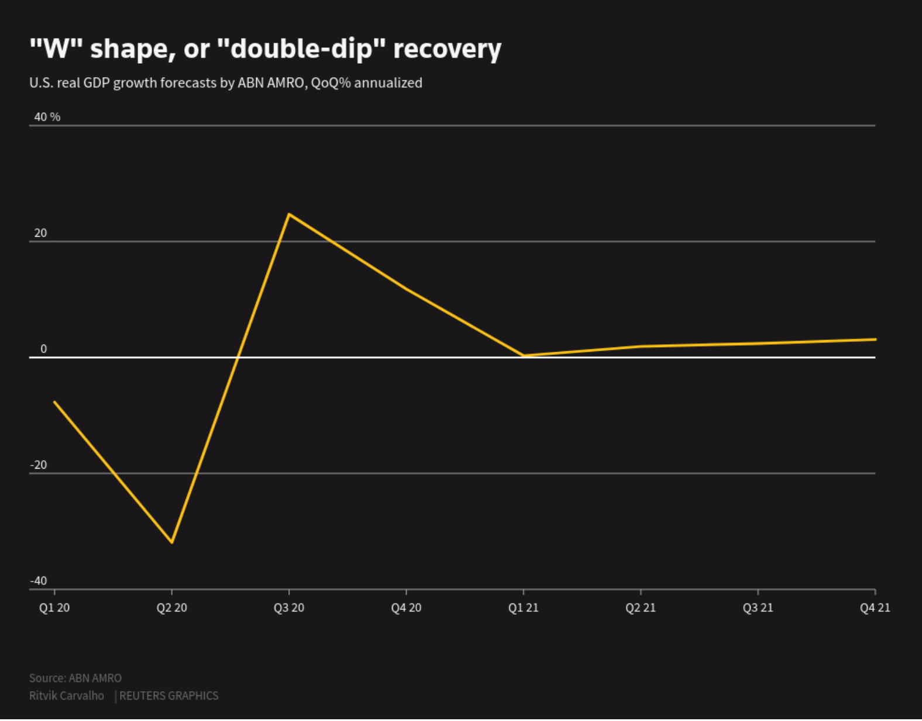
Post Outbreak – Predictive Models – Alphabet Soup
The best case outcome: when a growth plunge is followed by an equally sharp recovery
Likeliest outcome: When recovery takes more than a couple of quarters
More than 50 economists polled by Reuters, some forecast the world economy will shrink as much as 6% in 2020. The other extreme was a prediction for 0.7% growth. The average was a 1.2% contraction
Will it be V or U or W or L ? Medley of letters to indicate whether we can expect a bounce back, a slow-burn recovery or relapse.
Best case (V) vs. Worst (L)
Prolonged slump in multiple quarters resulting into a significant downside of the economy. Although there is a light to have Tick shape recovery – means gradually rising economy.
Graphic Source : reuters
When growth plunges and does not recover for some time. Unlikely but risky for those emerging markets less able to engage big stimulus and often rely on commodity exports
bias is the recovery looks less V- or U-shaped but more W-shaped. Double-dip - if the easing of lockdown restrictions initially boosts activity but the effects of unemployment and corporate bankruptcies then start to filter

Slide 5

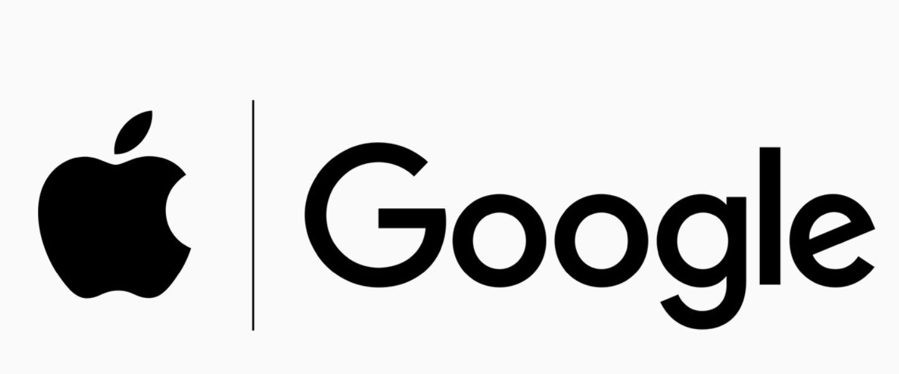
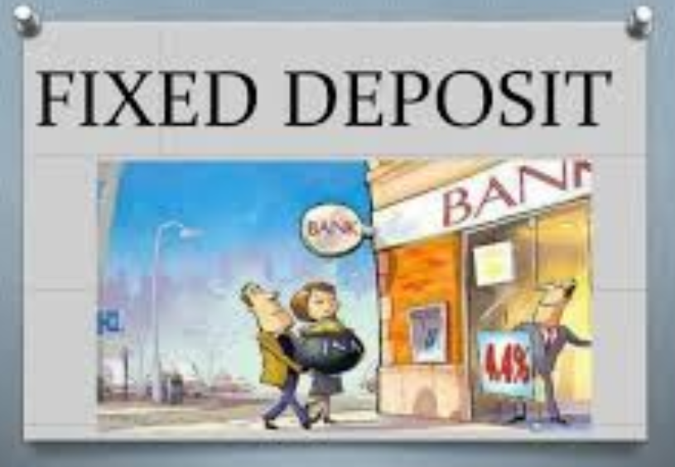
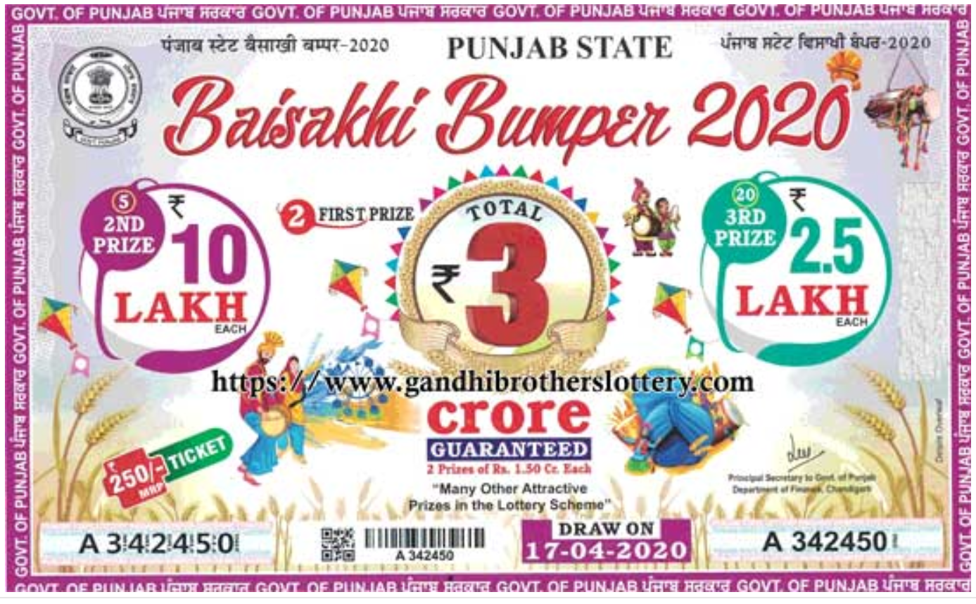
Finance – not just for the finance professional
To know whether the country is doing well or not, just look at the general Stock Market of the country.
Primary source of any kind of business expansion.
You can get good returns from the market even as a lay person and make your financial life in order.
We all know what cashflow is but should know how to float cash– more ROI.
Share Market is always running – Don‘t forget!
Knowing the STOCK MARKET is an extra Immunity ☺

Slide 6
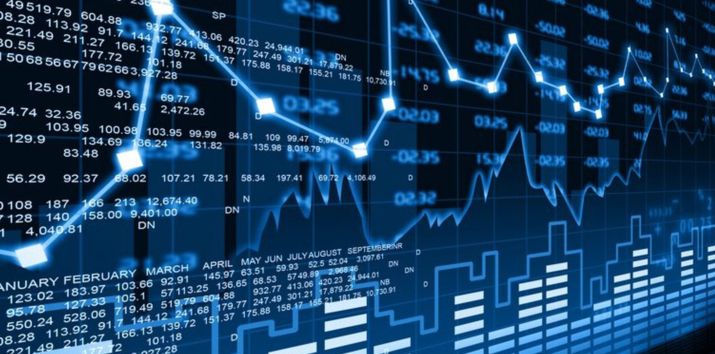
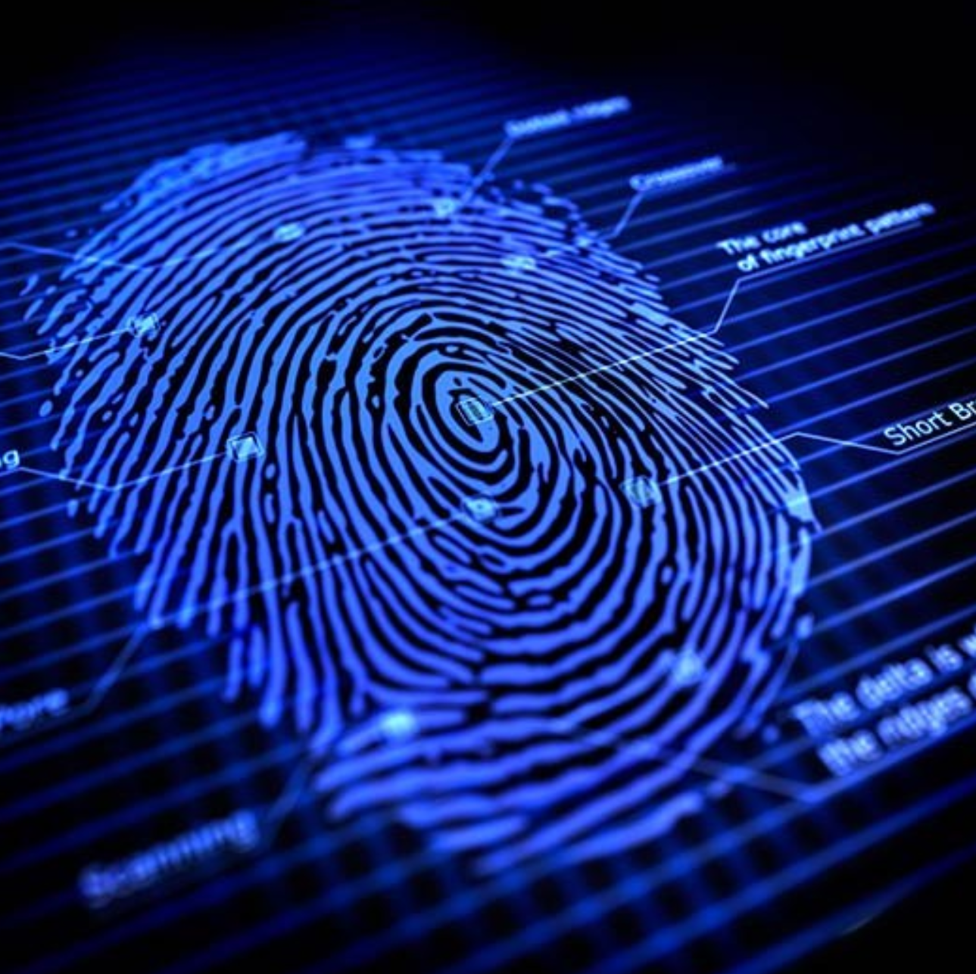

Digital Onboarding – Financial Market
The Traditional Era
3 snapshots from .COM Bubble
Cautious of Hype
Speculative Bubble
First Principles Thinking vs. Iterative
Technology Stack
By 2030!

Slide 7
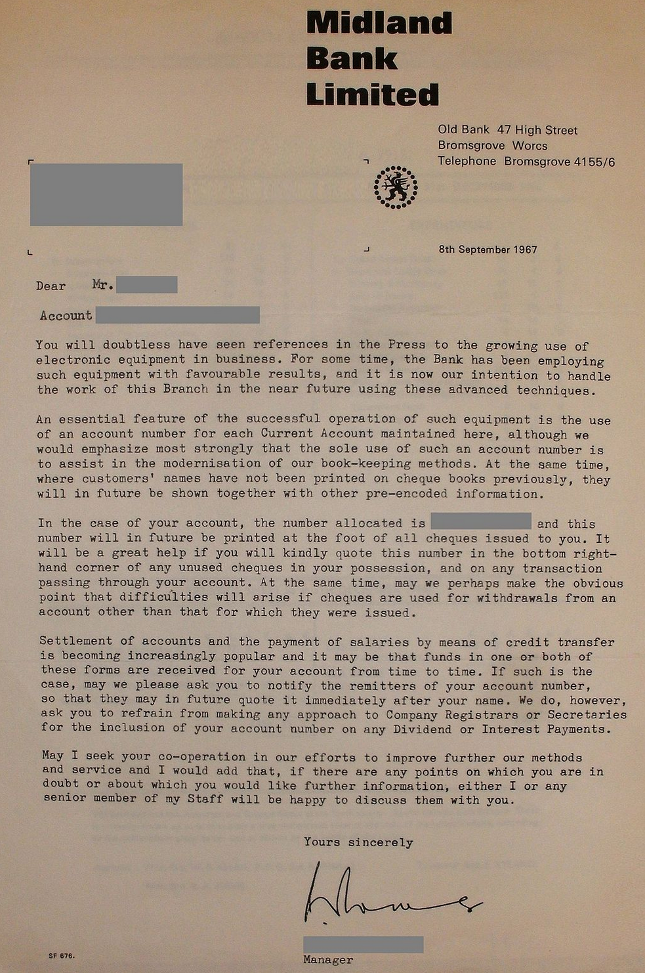
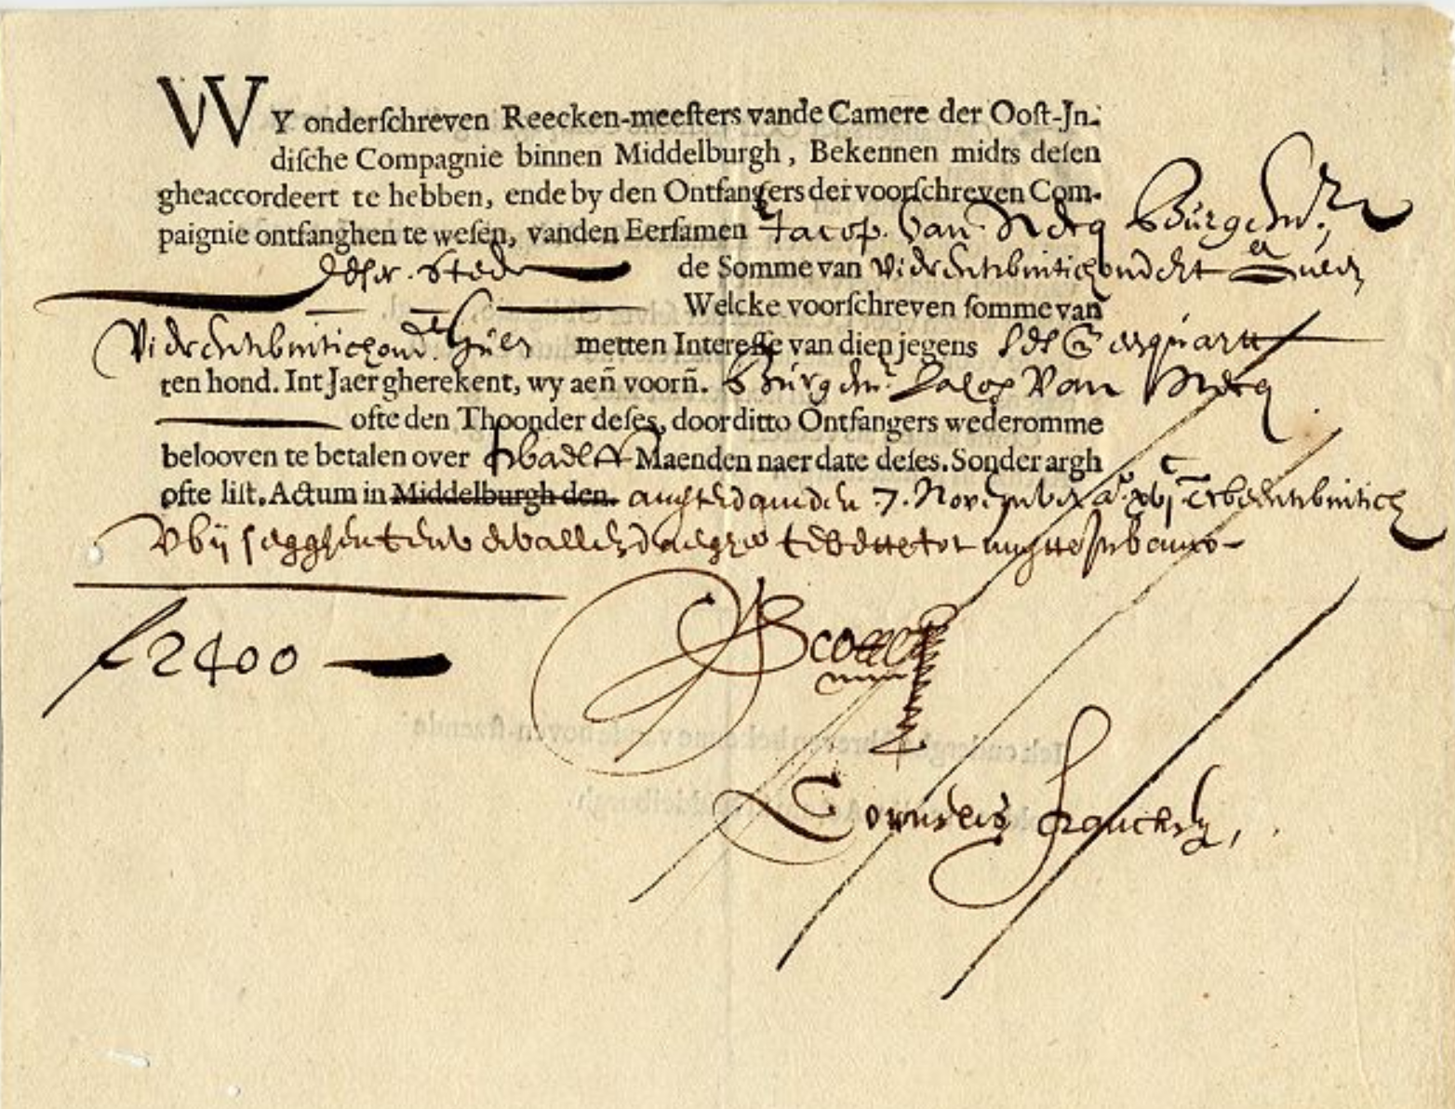
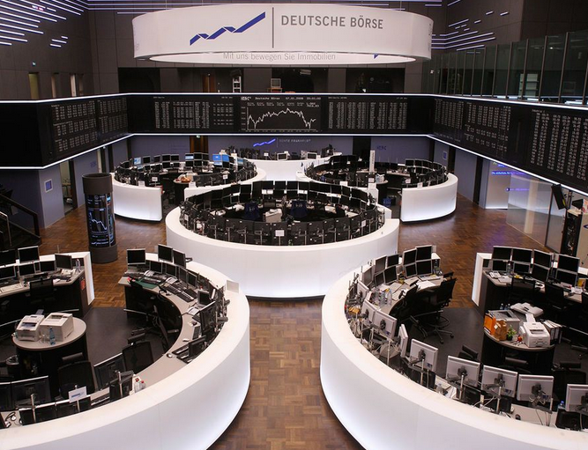
The Traditional Era
Paper based banking txn
Bank Account number
Physical Coupon, Bonds and Share certificate
Floor Trading
ATM
Debit / Credit Cards
Financial Advisors
Internet Banking / E-Commerce

Slide 8






3 Snapshots from .Com Bubbles
1999
2009
2019
World‘s Top-4 Companies (Market Cap)
GE
BigTech is getting into Finance
PetroChina
Exxon
ICBC
Regulation
Berkshire Hathway, Facebook, Alibaba, Tencent, Visa, JPMC
Finance Company
Tech Company

Slide 9
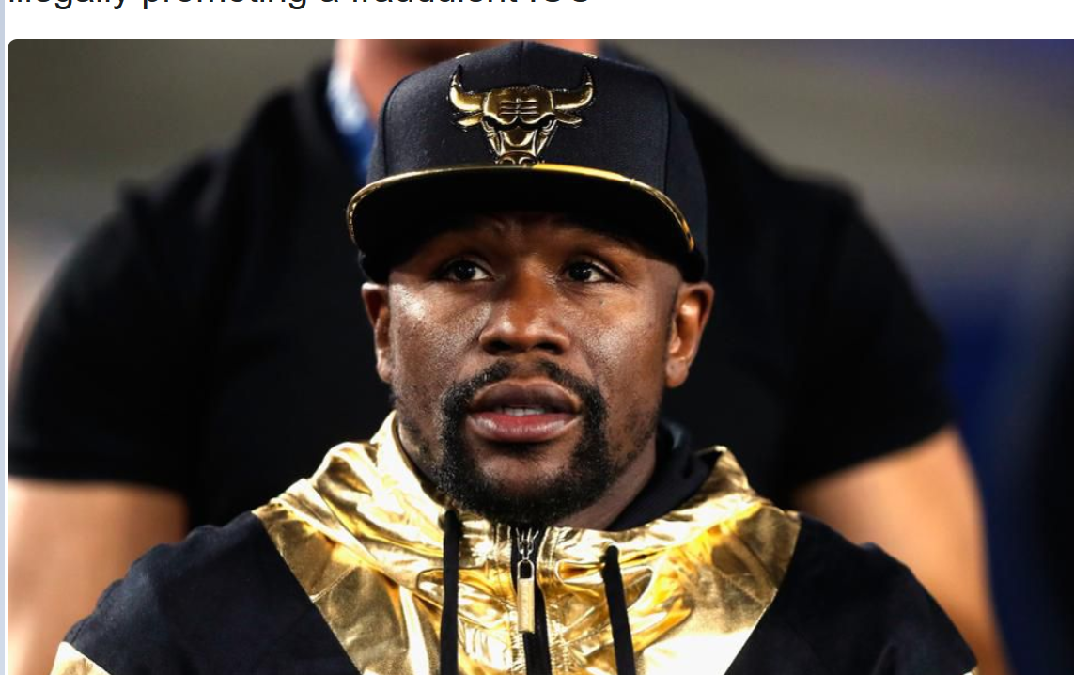

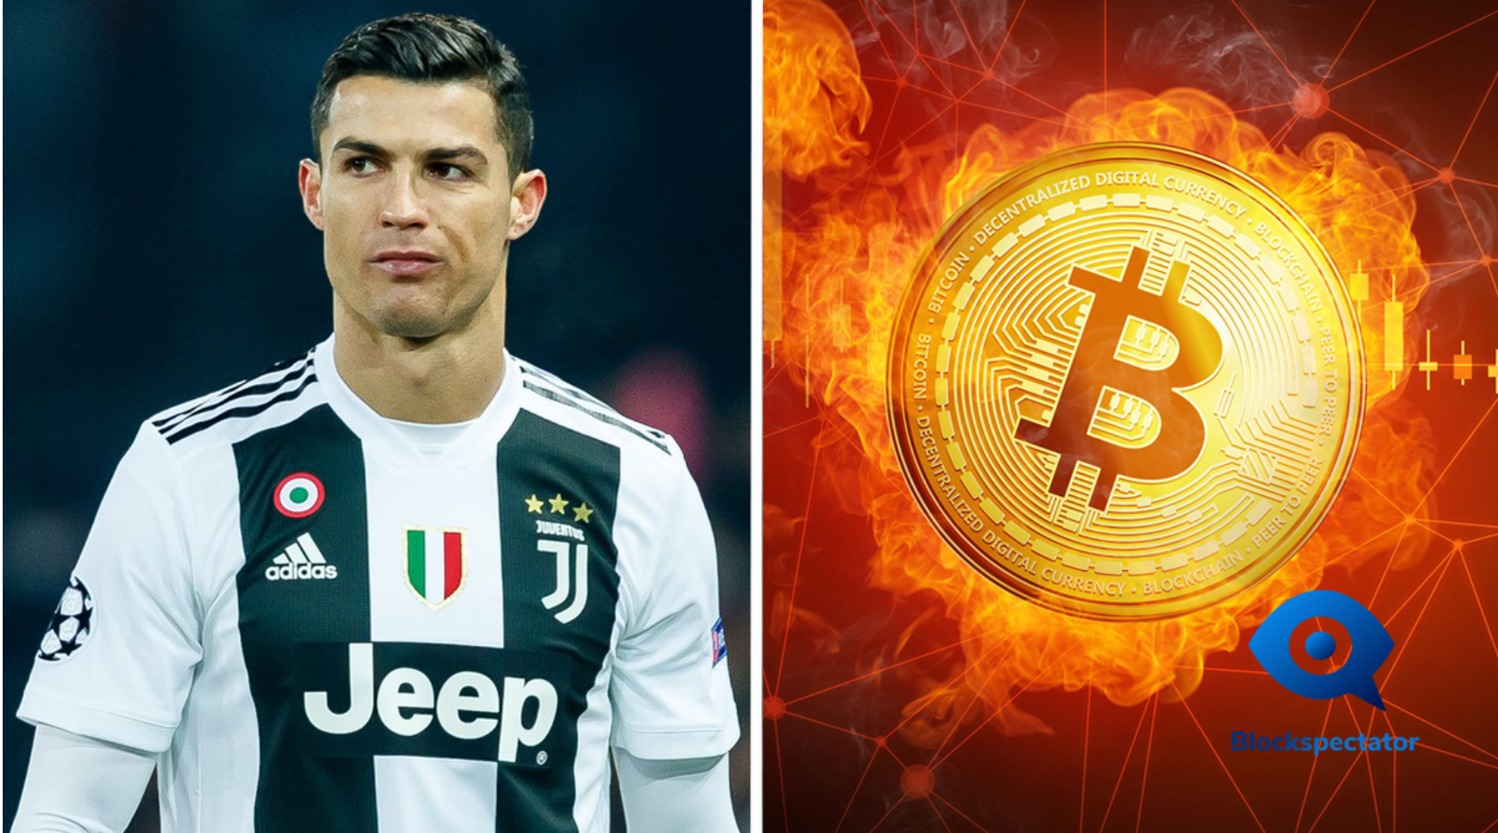


Cautios of Hype
Level of over excitement can cast the shadow on the actual real technological progress.
Long BlockChain
Corporation (2017)
430% in a day
Using .COM, over valuate by 75%
Cosmetic name or domain chnage -> change the market
No rational way to explain this than the hype or the over excitement of the market

Slide 10
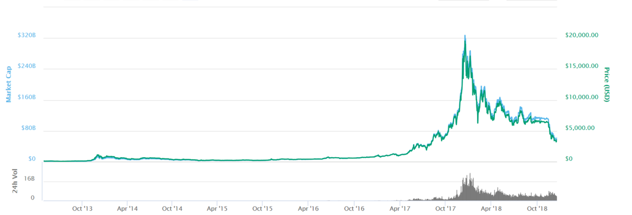

Speculative Bubble
Underlying excitement and psychological emotions forms this speculation
Initially bit of excitement due to new innovation
Leads to euphorical level of excitement
Inevitably panic sets in→ CRASH
Bitcoin Price Chart
Bubbles start slowly and then accelerate to unsustainable highs (on large volume) that are largely created by greed and fear but not fundamental evaluations.

Slide 11
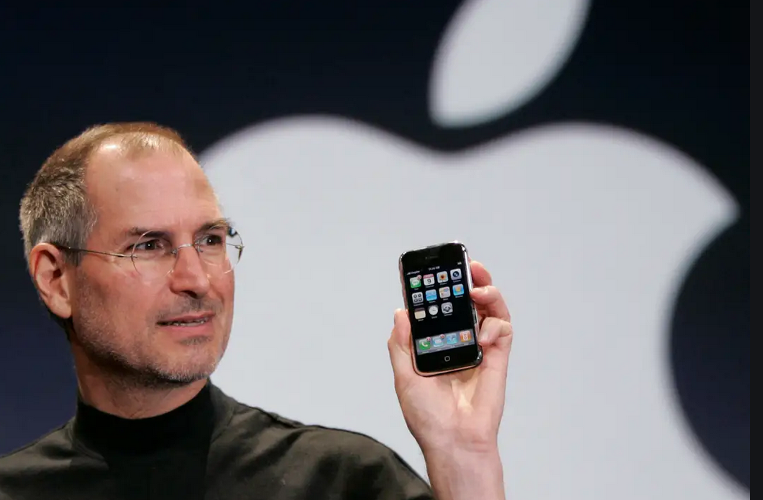
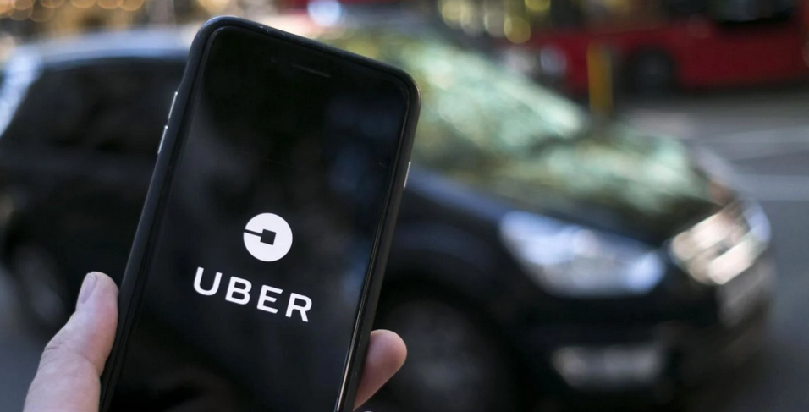
First Principles Thinking vs. Iterative

